Slide 2
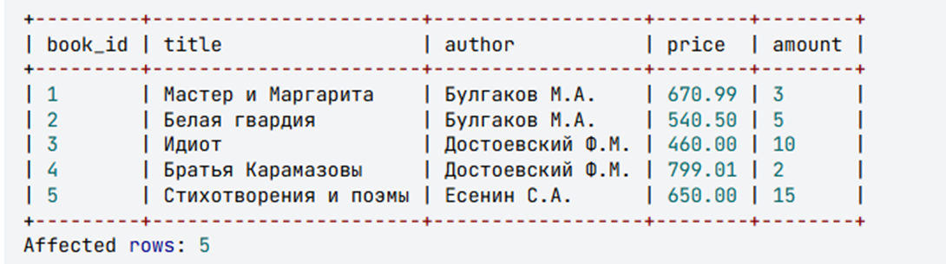
Selecting all data from a table
To select all data from a table, an SQL query of the following structure is used:
The keyword SELECT;
The symbol *;
The keyword FROM;
The table name.
The result is a table containing all the rows and columns of the specified table from the query.
Example
Select all records from the book table.
Query:
SELECT * FROM book;

Slide 3
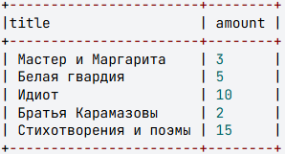
Selecting Specific Columns
To select data from specific columns of a table, an SQL query with the following structure is used:
The keyword SELECT;
A list of the table's column names, separated by commas;
The keyword FROM;
The table name.
The result is a table containing all the data from the columns specified after SELECT in the original table.
Example
Select the titles and quantities of books from the book table.
SELECT title, amount FROM book;

Slide 4
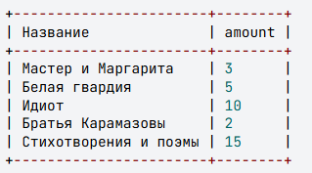
Assigning New Names to Columns in a Query Result
To select data from specific table columns and simultaneously assign them new names in the output, an SQL query with the following structure is used:
The keyword SELECT;
The column name;
The keyword AS;
The new column name for the query result (you can use Russian letters, but it must be a single word; if the name consists of two words, connect them with an underscore, e.g., Kolichestvo_knig);
A comma;
The next column name;
...
The keyword FROM;
The table name.
A single query can use both the original column names from the table and new assigned names.
The result is a table containing all the data from the columns specified after SELECT in the original table. Each column in the result is given the new name specified after AS, or it retains the original column name from the table if AS is omitted.
Example
Select all book titles and their quantities from the book table, assigning the column title the new name Название.

Slide 5
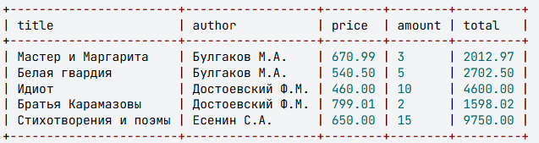
Selecting Data with a Calculated Column
SQL queries can perform calculations for each row of a table using a calculated column. This is specified in the field list after the SELECT operator by providing an expression and assigning it a name.
The expression can include:
Column names
Constants
Arithmetic operators
Built-in functions
The result is a table containing all data from the columns specified after SELECT, plus a new column where each row displays the computed value of the given expression.
Listener's note: You can perform arithmetic and logical calculations across an entire column, with the result being a new column.
Example
Display all information about books, and for each entry calculate its total value (price multiplied by quantity). Assign the name total to the calculated column.
SELECT title, author, price, amount, price * amount AS total FROM book;

Slide 6
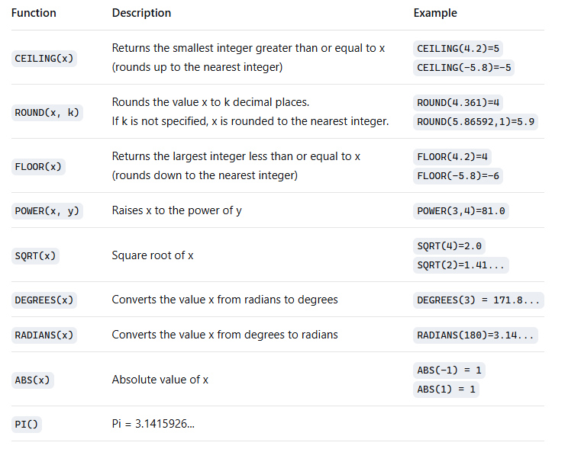
Selecting Data, Calculated Columns, Mathematical Functions
SQL implements numerous mathematical functions for working with numerical data. The table below lists some of them.
Explanation: There are different methods for rounding numbers. SQL implements mathematical rounding (round half up). To round a real number, you select the digit in the fractional part to which you are rounding. The digit in the selected position:
Remains unchanged if the digit immediately to its right is 0, 1, 2, 3, or 4.
Increases by one if the digit immediately to its right is 5, 6, 7, 8, or 9.

Slide 7
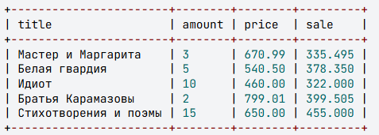
Selecting Data, Calculated Columns, Logical Functions
SQL provides the capability to assign a value to a field based on a condition. This is done using the IF() function:
IF(logical_expression, expression_1, expression_2)
The function evaluates the logical_expression. If it is TRUE, the field takes the value of expression_1; otherwise, it takes the value of expression_2. All three parameters of the IF() function are mandatory.
The use of nested functions is permitted, meaning a new IF function can be used in place of either expression_1 or expression_2.
Example
Let's set a discount for each book in the book table as follows: if the number of books is less than 4, the discount will be 50% of the price; otherwise, it will be 30%.
SELECT title, amount, price, IF(amount < 4, price * 0.5, price * 0.3) AS discount FROM book;

Slide 8

Selecting Data, Logical Operations
The logical expression following the WHERE keyword can include not only comparison operators and expressions but also logical operations (AND, OR, NOT) and parentheses, which change the order of operation precedence.
Order of Precedence:
Parentheses ()
Multiplication (*), Division (/)
Addition (+), Subtraction (-)
Comparison Operators (=, >, <, >=, <=, <>)
NOT
AND
OR
Example
Select the title, author, and price of books written by Bulgakov with a price greater than 600 rubles.
SELECT title, author, price
FROM book
WHERE author = 'Булгаков М.А.' AND price > 600;

Slide 9
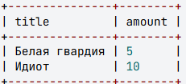
Selecting Data, BETWEEN and IN Operators
The logical expression following the WHERE keyword can include the BETWEEN and IN operators. The precedence of these operators is the same as that of the comparison operators, meaning they are executed before NOT, AND, and OR.
The BETWEEN operator allows you to select data within a certain range, including the boundary values.
Example
Select the titles and quantities of books whose quantity is between 5 and 14, inclusive.
SELECT title, amount
FROM book
WHERE amount BETWEEN 5 AND 14;
SELECT title, amount
FROM book
WHERE amount >= 5 AND amount <=14;

Slide 10
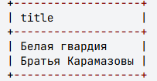
Selecting Data, the LIKE Operator
The LIKE operator is used to compare character strings. Unlike the equality (=) and inequality (<>) operators, LIKE allows for pattern matching instead of exact match comparison. The pattern can include regular characters and wildcard characters. During comparison, the regular characters in the pattern must exactly match the characters in the string. Wildcard characters can match arbitrary elements of the character string.
Example 1
Select the titles of books that start with the letter "Б".
SELECT title FROM book WHERE title LIKE 'Б%';
Wildcard | Description | Example
% | Matches any string of zero or more characters. | SELECT * FROM book WHERE author LIKE '%М.%' This searches for and returns all books where the author's initials contain "М."
_ (underscore) | Matches any single character. | SELECT * FROM book WHERE title LIKE 'Поэм_' This searches for and returns all books whose titles are "Поэма", "Поэмы", etc.

Slide 11
Selecting Data, the LIKE Operator
Example 2
Select the titles of books that consist of exactly 5 letters.

